Slide 1



LASER
Light amplification by stimulated emission of radiation
By vurpo

Slide 2

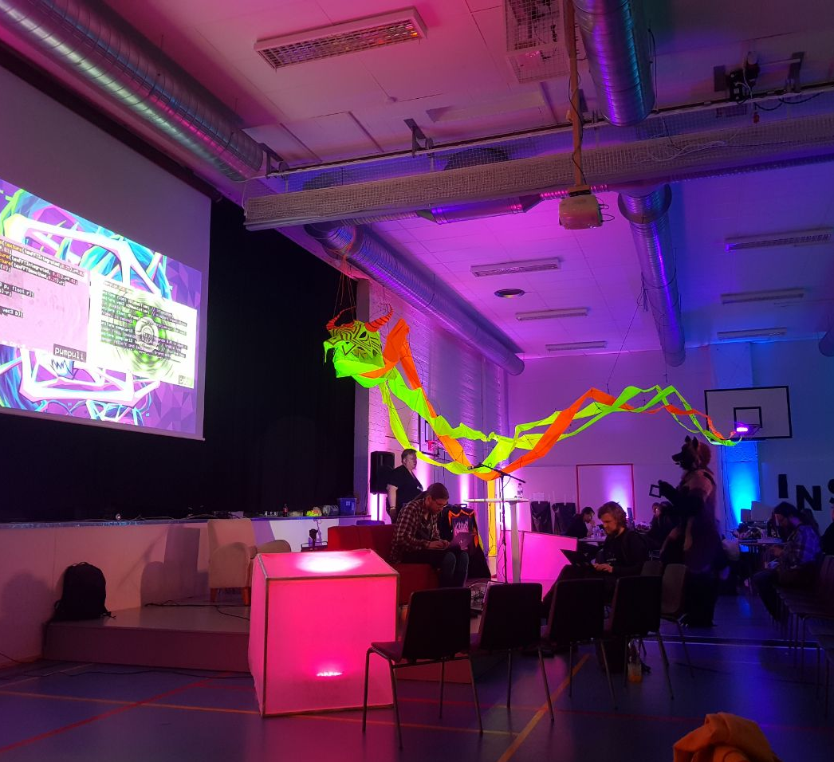
DEMO STRUCTURE
Music
Realtime rendered graphics
PowerPoint slides

Slide 3

What is laser?
The first lasers were developed in the united states in 1960
Lasers are used, among other things, to read cds
In industry, lasers are used for welding and cutting
In medicine, lasers are used for surgery

Slide 4
Compact disc (CD)
Compact discs are one of the most common everyday usages of lasers, but it is only one of many
Compact discs are read using a laser only around 100 milliwatts, but the most powerful lasers in the world reach into the several petawatts

Slide 5
Star Wars ”lasers”
These are not lasers
In movies, laser beams are often incorrectly presented as resembling a ballistic projectile

Slide 6
Are there lasers in this scene?
YES
You just can't see them (lasers are not visible in regular air)

Slide 7


Does the following scene have any lasers in it?
No?
Remember, not visible in regular air
Can we add some smoke to figure out?

Slide 8


GREETINGS
My friends
fieldfx community
Raccoonviolet
Jumalauta
Instanssi people
skrolli
rust and webgpu
Microsoft office
apple m1 gpu
Wii u enthusiasts
hacklab.fi
Assembly
You

Slide 9
Credits
Code, graphics, music: vurpo
Instanssi photo: RaccoonViolet

Slide 10

QUESTIONS?

